Slide 1
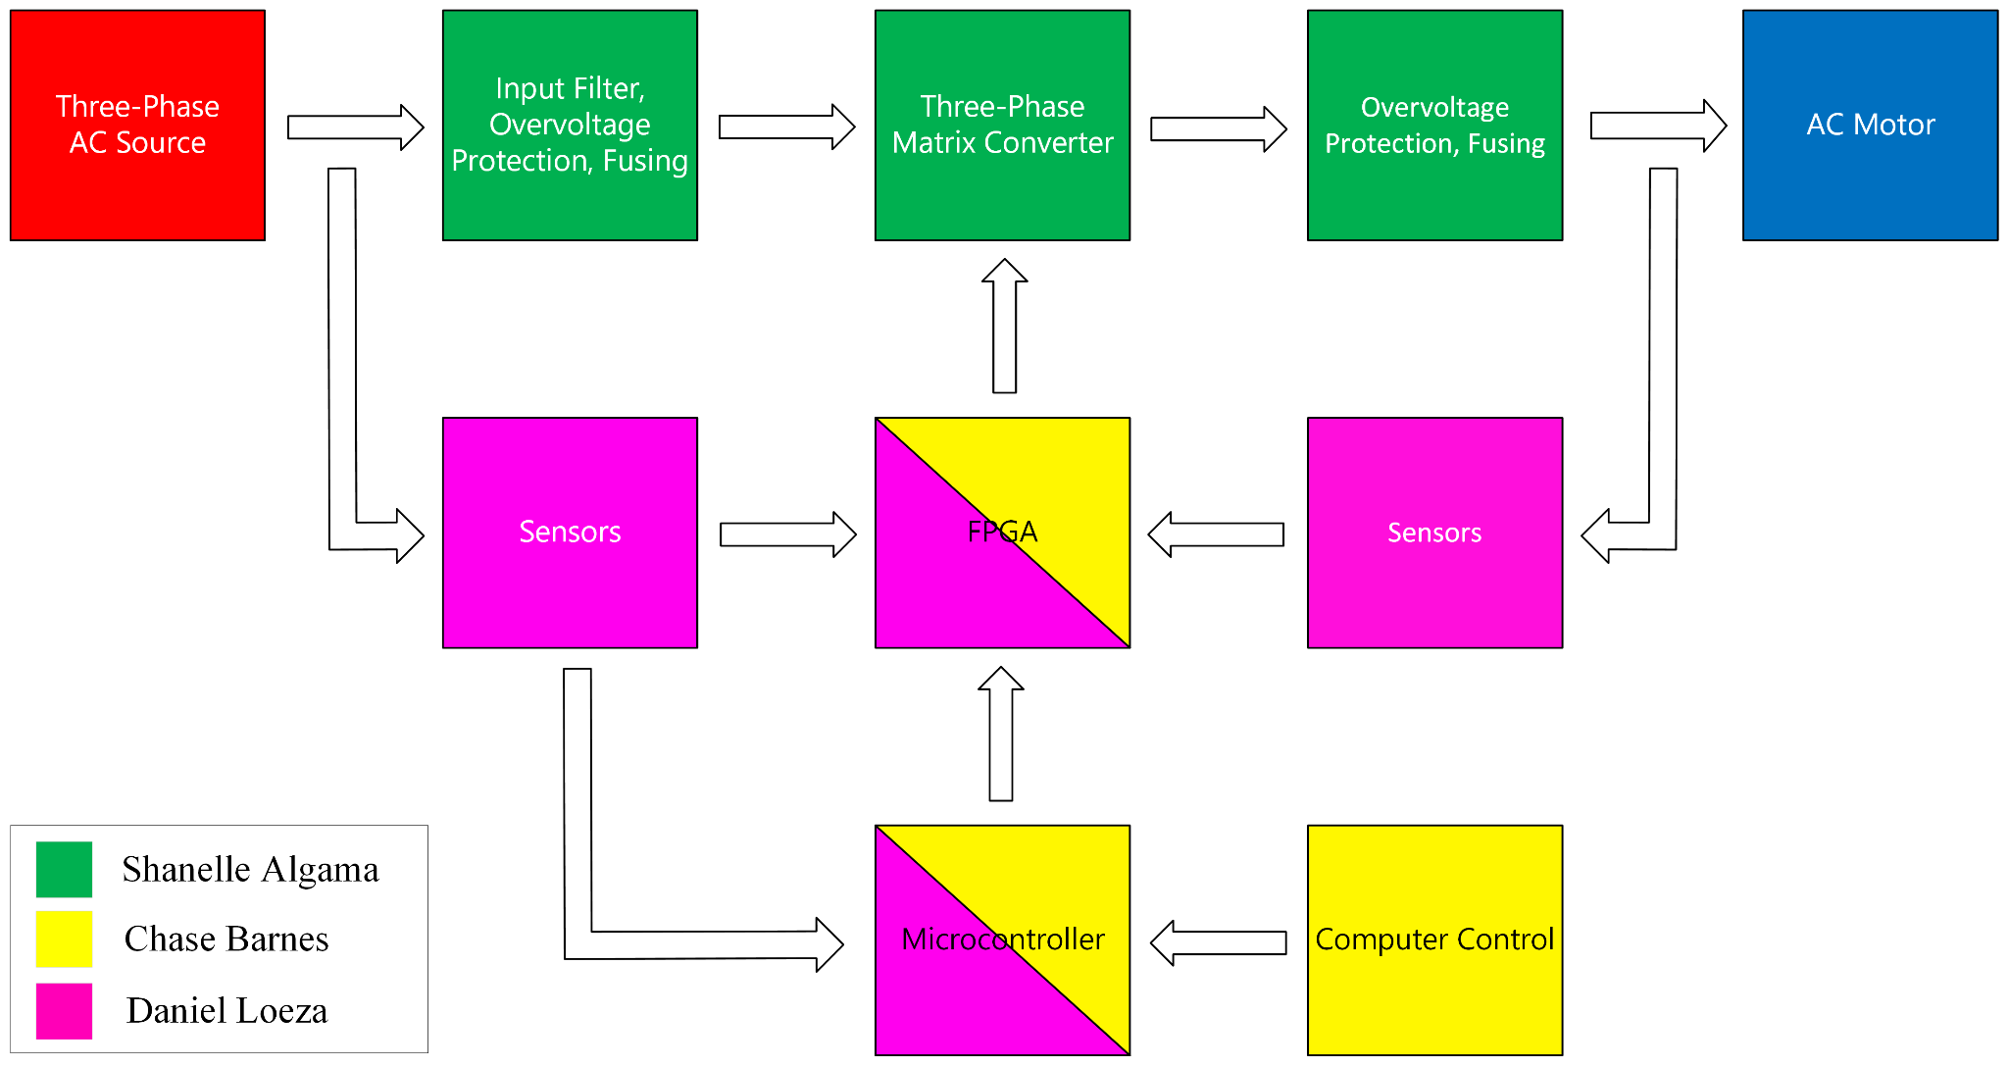
Team 20: Three-Phase Matrix Converter
Needs Analysis Problem Statement Design Proposal | Subsystem Development - Prototype

Slide 2
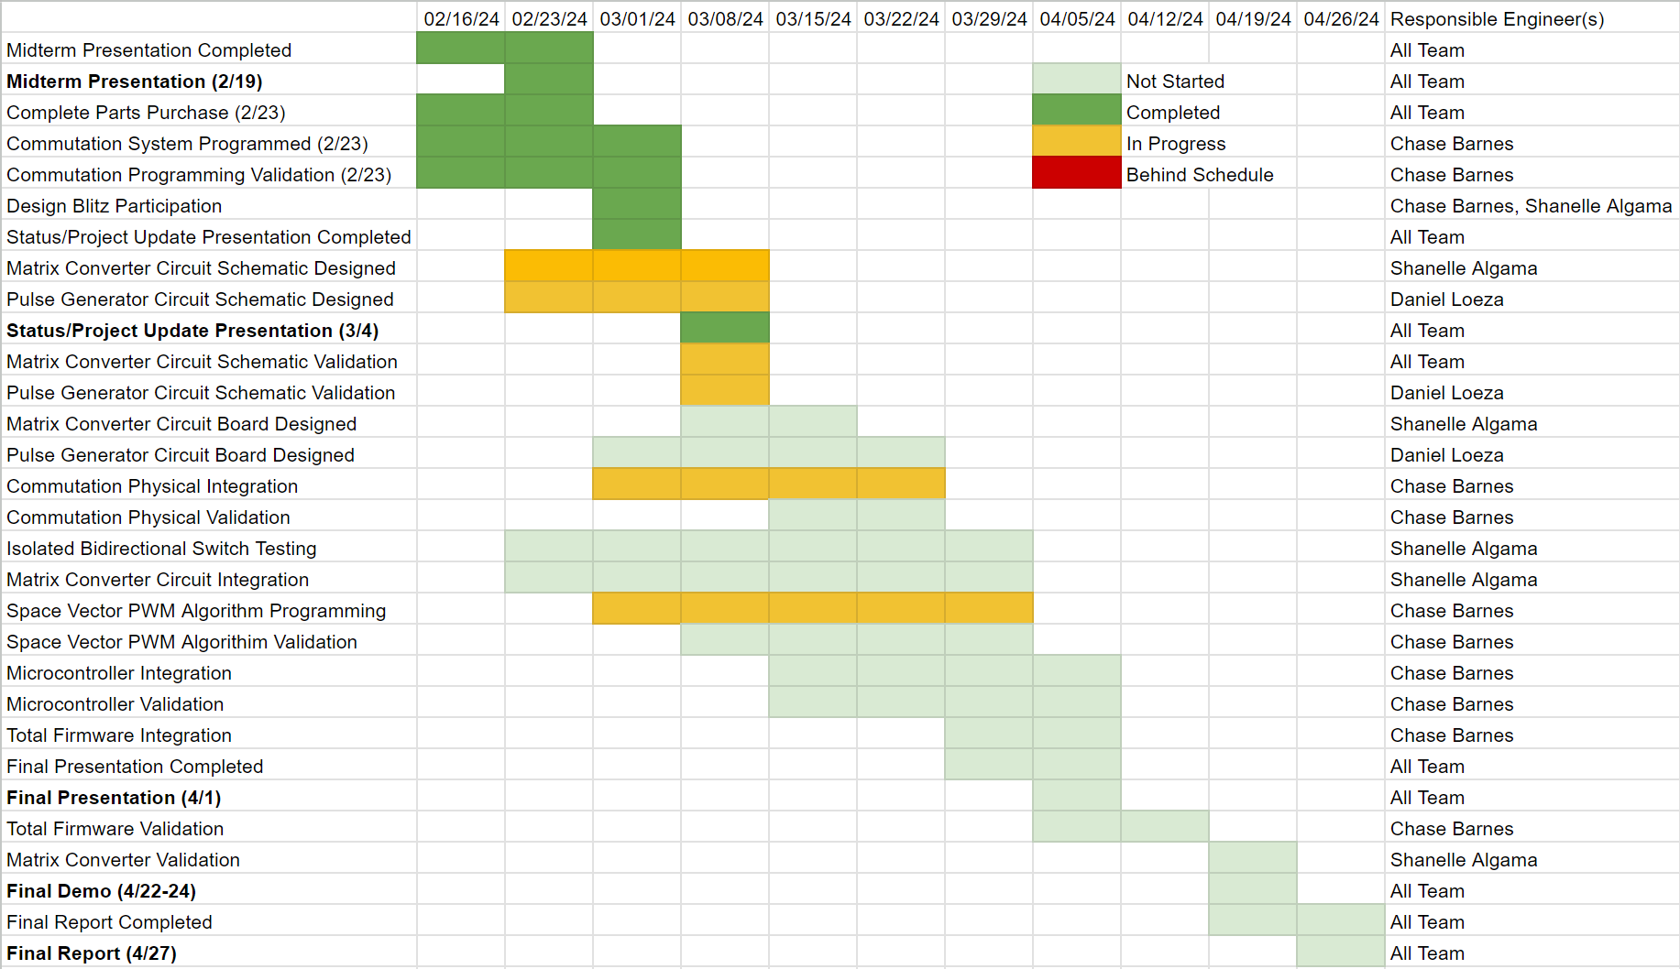
Team 20: Three-Phase Matrix Converter

Slide 3
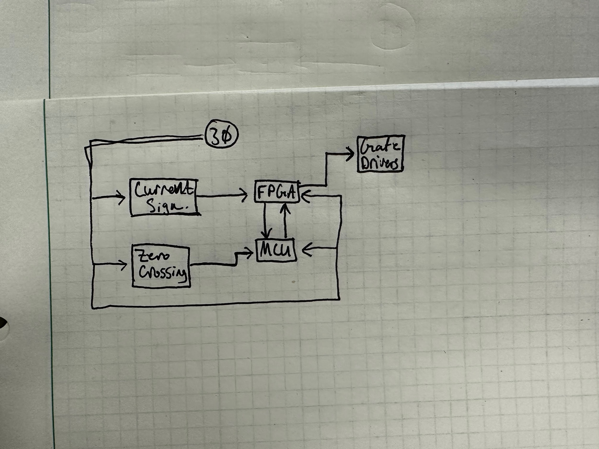
Pulse Generator Daniel Loeza
Accomplishments since the last presentation 8 hrs | Ongoing progress/problems and plans until the next presentation
The MCU, FPGA, zero-crossing detector, and the current sign detector have been selected based on the design criteria. | Connecting the zero-crossing and current sign detectors to the FPGA/MCU. Designing the interfacing between the MCU and computer.

Slide 4
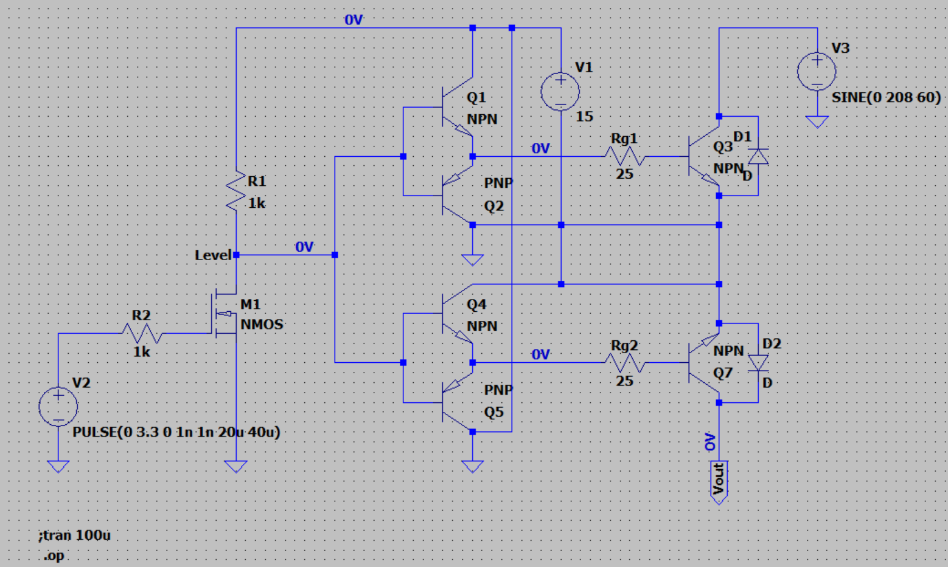
Matrix Converter Shanelle Algama
Accomplishments since the last presentation 8 hrs | Ongoing progress/problems and plans until the next presentation
-The first schematic prototype of the bidirectional switch was created using a BJT push-pull gate drive topology -The pulse source and resistor emulates the FPGA signals, and M1 emulates the isolation and acts as a level shift to the gate driver - Ran into problems with simulations such as DC Operating Point and Transient Analysis | -I’ll be fixing the circuit and improving the design as needed -My goal is to figure out parameters such as optimal Rg value for slightly underdamped response, optimal current draw into gate drivers, and what to expect on each nodal output -Potentially start creating a full schematic of all switches

Slide 5
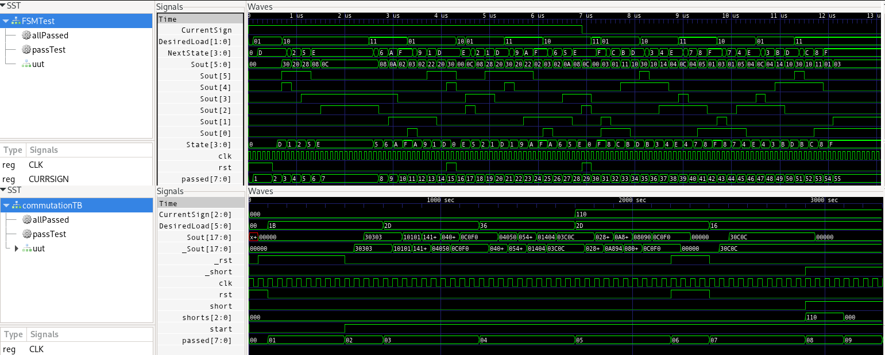
FPGA and MCU Firmware Chase Barnes
Accomplishments since the last presentation 18 hrs | Ongoing progress/problems and plans until the next presentation
-Commutation system has full coverage for state machine, and coverage for whole implementation -Started flashing to FPGA dev board -started work on space vector modulation algorithm | -Continue working on space vector modulation algorithm -Flashing on dev board having issues I haven’t yet resolved

